Slide 1
ChangAn C385
MFC5J3 smart camera kick-off
2021-11-11

Slide 2
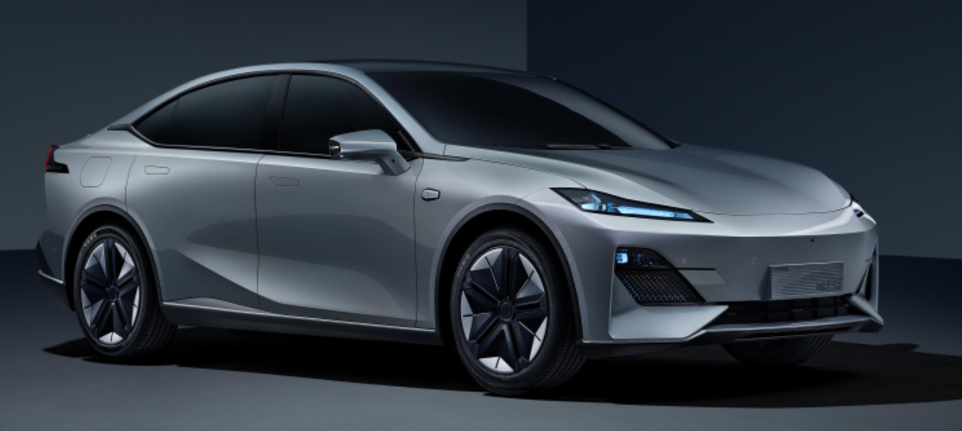
Catalog
1. Continental & ChangAn contact person list
2. ChangAn SDA Platform HW solution
3. Product Architechture
4. Software Architechture
5. Project plan
6. Focus driving function MRM-safe stop
7. Remark Point & Following Task & Potential Risk
8. MRM feature development Key point
9. ACC Design for MRM state triggering
C385

Slide 3
1. Continental & ChangAn contact person list
Continental
Name | Position | Email | Phone
Wang Jianjun | PM | david.wang@continental-corporation.com | 13681680385
Yan Jianfeng | TPM | jianfeng.yan@continental-corporation.com | 13661524991
Yao Yao | Sys | yao.3.yao@continental-corporation.com | 13564690550
Wang Yusen | PD | yusen.wang@horizon.ai | 17602142630
Yan Min | SW | Min.Yan@continental-corporation.com | 15821178843
Liu Jiafa | ME | jiafa.liu@continental-corporation.com | 17317570607
Yu Jiabo | HW （EE,OM) | jiabo.yu@continental-corporation.com | 15900588269
He Fengchun | Test | fengchun.he@continental-corporation.com | 13818369207
Gong Yu | QM | Yu.Gong@continental-corporation.com | 18621710651
Zhang Shunmin | SM | shunmin.2.zhang@continental-corporation.com | 13761637949
Continental SW interface
Name | Interface | Email
Zhao Jing08 | Arch | jing.8.zhao@continental-corporation.com
He Zhengyi | BSW | zhengyi.he@continental-corporation.com
Wei Yefei | HLA, TSA | yefei.wei@continental-corporation.com
Chen Long | AEB | long.cheng@continental-corporation.com
Chen Yuan | CEM | y.chen-ext@continental-corporation.com
Liu Yang17 | ACC | Yang.17.liu@continental-corporation.com
Huang Wei | LCF | wei.5.huang@continental-corporation.com
Ma Mengwen | LCF | mengwen.ma@continental-corporation.com
He Yinchuan | VDY | yinchuan.he@continental-corporation.com
Jiang Xiehang | Integrator | xiehang.jiang@continental-corporation.com
ChangAn
Name | Position | Email | Phone
Rao Jiangwei | Interface | raojw@changan.com.cn | 17783462556

Slide 4
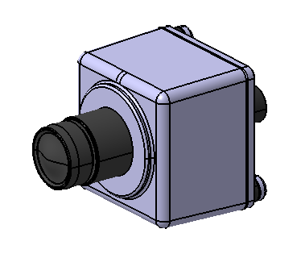
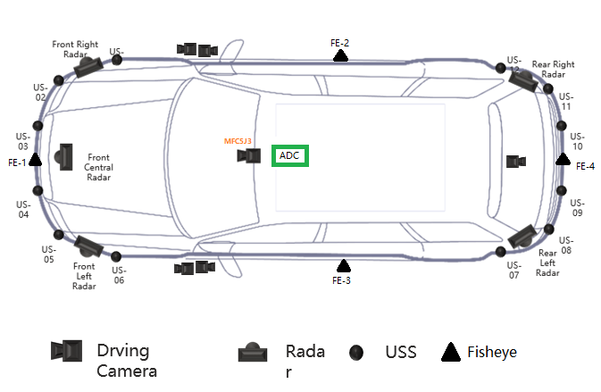


2. ChangAn SDA Platform HW solution
Main Cam
120°@8MP OV OX08b40 RGGB
LVMS
LVDS
VDC
longitudinal control
CAN-FD
MFC5 J3
1000M ETH
TC387
J3
ADC
CAN-FD
Only ACC & LCF backup on MFC5J3
lateral control
Rear Left
Radar
CAN-FD
Rear Right
Radar
SenseTech
4D Radar

Slide 5
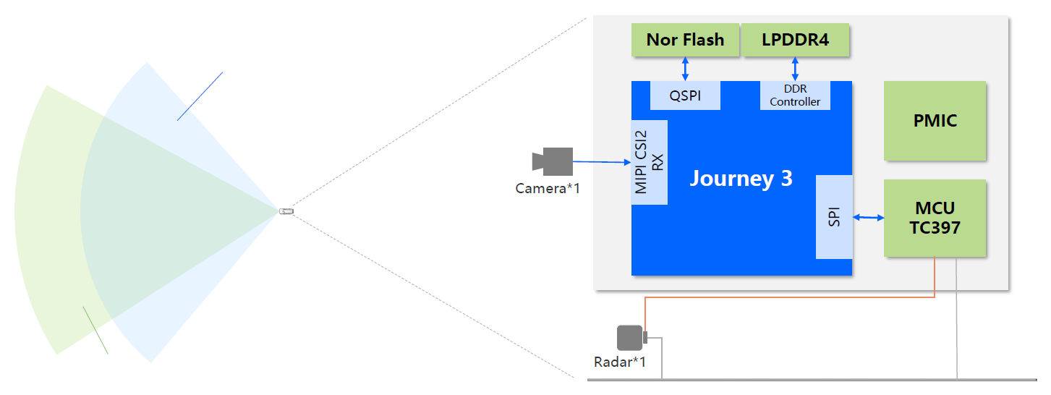
MFC5J3 Solution Overview
3. Product Architechture
Dual Chip solution:
Video Processor SoC（HR J3）
MCU（Infineon TC387）
1R1V
Front Monocular Camera
8.3MP @ 30FPS
FOV 120°
TC387
Private CAN
ARS5xx
3rd-party supplier
Public CAN
Fucntion Support：IACC、ACC、AEB、LKA、 LDW、TSR、FAB、TLA、ELK（Partial function）
Extension possible to 3R1V
Notes:
IACC – Integrated Adaptive Cruise Control

Slide 6
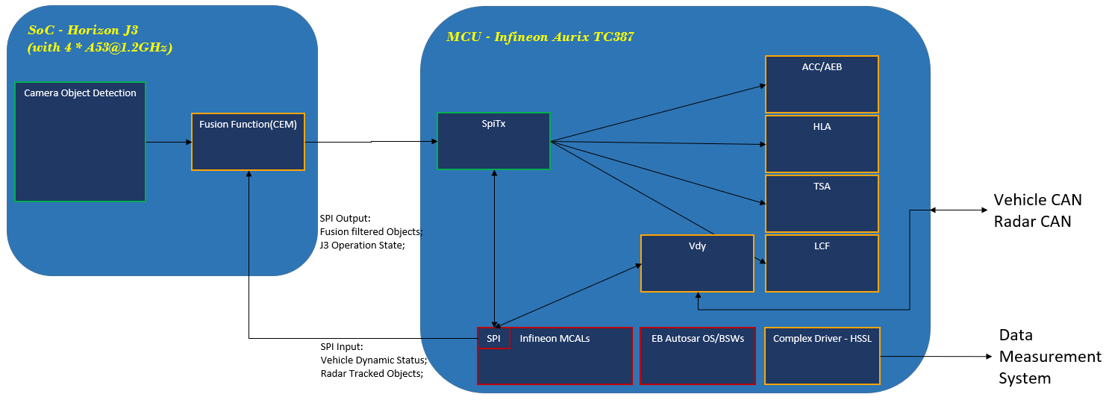
4. Software Architechture
HR J3: Vision perception，Fusion
TC387: Function

Slide 7
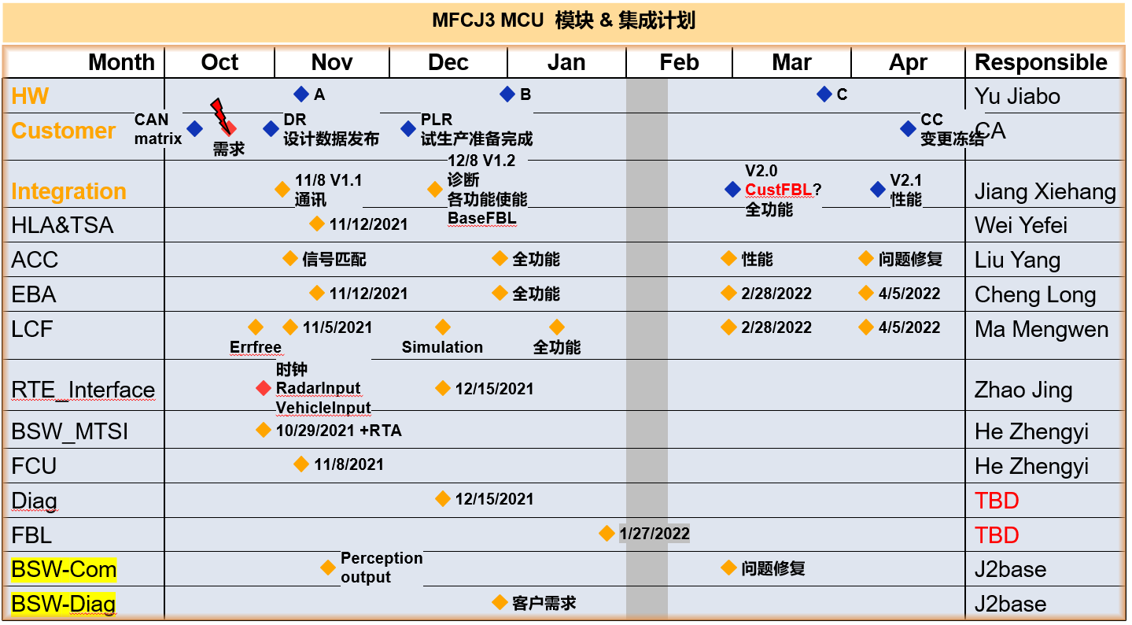
5. Project plan
Signal mapping
Full functionality (wo/ MRM)
Performance
Issue fix

Slide 8

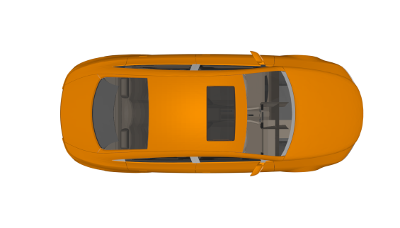
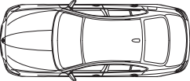
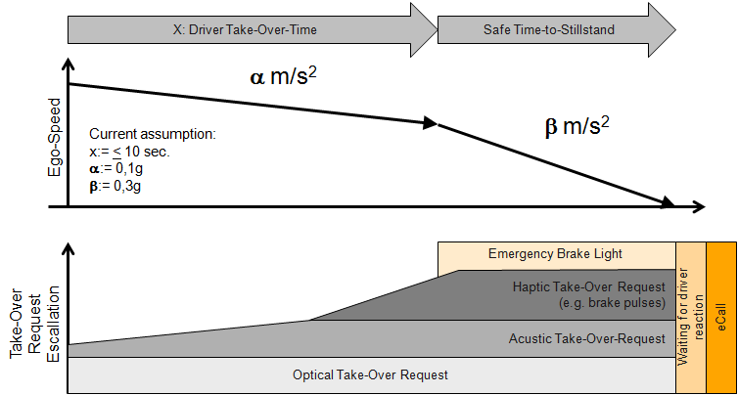

6. Focus driving function MRM-safe stop Continental internal solution
Basic Use Cases:
Lane Keeping
Vehicle Deceleration
Environmental Sensor Capability
Function Scope
Bring the vehicle into a safe state in case the ADC failure and hands-off status.
Allow the driver to take over the driving task, by automatic deceleration and lane keeping
Cascaded Function approach
low deceleration (0,1g) up to 10s, afterwards deceleration with 0.3g to standstill
EBA and Distance Control
Standstill control if vehicle is coming to a full stop
Monitoring driver and release control if driver takes over driving task
Driver Experience/Interaction:
Moderate vehicle deceleration until stand still
Lane Keeping during deceleration maneuver
Activation of hazard warning light
Function is overrideable by active driver
Lane detection
Dynamic/Static Objects detection
Vehicle Velocity 0…60 kph
Environmental Conditions:
All weather up to sensor limitations
Intended for use on highways
opt.
opt.
opt.
opt.
Legal Mandatory (y/n): no
NCAP Relevance (y/n): no
Applicable standard: n/a
ISO 26262 (Item ASIL): (tbc)
AD SAE Level: n.a. (safety function)
Sense: tbd
Plan: tbd
Act: tbd
Notes:
MRM：在驾驶自动化系统或用户无法执行动态驾驶任务或动态驾驶任务接管时，驾驶自动化系统所采取的降低风险的措施。
When Driver cannot takeover ADAS system dynamic driving task, ADAS sys take actions to minimize the risk.
ACC + LKA

Slide 9
7. Remark Point & Following Task & Potential Risk
Remark
Conti ACC should working once ADC’s IACC start working and exit independently
Actuators will not respond to Conti ACC but only when ADC failure (Some of ACC feature could be simplified)
MRM need to ensure performance
Task
ASIMA mapping to ChangAn CAN Matrix –Dec. 15
FPS + CEM adaption –Dec. 15
Original ACC modification –Dec. 15
MRM feature development --TBD
Verify ACC algo in SIL or HIL -- Dec. 31
Performance tunning – Feb. 28
Risk
MRM is new feature without clear specification, many open point need to be discussed with ChangAn
Conti ACC state machine coordinating with ADC ACC (mainly for Stop&GO)

Slide 10
8. MRM feature development Key point
New SM design for “MRM”, “failure” & “passive” state
Vehicle Stop and Go state transition update
If driver not takeover steering and accelerator and brake: MRM decelerate with calibrate AxTar (-2m/s2) to stop and trigger EPB applied
If driver takeover steering but not accelerator and brake: MRM keep current speed
If driver only takeover brake: MRM exit
If driver only takeover accelerator: MRM exit after 5s or once driver takeover steering
MRM use maximum longitudinal deceleration (-3m/s2) when:
object exist with low speed
LCF cannot working(lane not clear or LCF degraded)

Slide 11
9. ACC Design for MRM state triggering
MRM control trigger condition
Need to receive IACC exit type to decide
MRM
ACC state
Active
Active
Standby
Standby
OFF
Condition
ADC_Available == TRUE
ADC_Available == TRUE
IACC_Mode == Active && IACC_Mode_lastCyc == Not Active

Slide 12
9. ACC Design for MRM state triggering
if (IACC_Normal_exit == true)
{
ACCstatus = Standby;
}
else if (ADC_Available != True)
{
ACCstatus = MRM;
}
else
{
ACCstatus = IACC_Mode;
}
Different IACC exit type leading to different ACC state
MRM
Active
Active
Normal exit: press switch, lane not clear, overspeed, turning light, 4 level alert 10s, etc.
Reversible exit: driver override
Abnormal exit: other non-defined exit
Standby
IACC Exit ADC Status | Normal exit | Reversible exit | Abnormal exit
Available
Not Available
Standby
Active
Standby
Standby
MRM
MRM

Slide 13
9. ACC Design for MRM state triggering
1. Decelerate with calibrated AxTar
OR Keep current speed
2. Brake light request
AND take over request
AND Voice Alert
MRM control flow
MRM
ACC state
Active
Standby
Standby
OFF
Passive
ADC_Available == TRUE
ADC_Available == False
IACC abnormal exit
ADC_Available == TRUE
IACC_Mode == Active && IACC_Mode_lastCyc == Not Active
Condition
Driver takeover control
OR Safe stop to standstill w/ EPB applied
ADC_Available == TRUE

Slide 14
Thank You！
感谢！

